Slide 1

The Future Water Story
Post-visit lesson

Slide 2
Teacher instructions
Post-visit: Concluding Lessons
Length: Approximately 100 minutes
Description: Students participating in the Future Water Story at the Western Treatment Plant, will explore the theme:
How can we manage Melbourne’s water sustainably as a valuable renewable resource?
This lesson sequence is aimed at bringing all the different ideas and concepts students have learnt while taking part in the Future Water Story; and encouraging them to generate and communicate their ideas on how to use water sustainably.
***See Notes on each slide for more teaching ideas***

Slide 3
Learning outcomes
Demonstrate understanding of key water sustainability concepts – Students identify and explain factors contributing to water scarcity and sustainable water management in Melbourne and the sewage treatment process.
Reflect on their decision‑making during the Future Water Story – Students explain their decisions and these affected the city over time. They will evaluate how the sustainability pillars may have influenced their decisions
Analyse environmental change over time – Students compare and contrast changes in land use, water, vegetation and built environments and use judgement to understand the impacts of those changes.
Apply knowledge to design a sustainable city – Students will design their own city and propose water-secure solutions for a growing population.
Develop and communicate a long-term water management plan – Students will apply their previous knowledge to develop their own community water management plan and propose individual and collection actions.
Reflect on their learning
Notes:
Teaching notes & ideas:
You may want to add how population growth will also impact water security in Melbourne.
The focus of the Future Water Story is on Melbourne, you could add reference to other cities around the world your class is investigating.

Slide 4
Lesson sequence
The following is a suggested sequence of activities and time allocation. All resources can be edited to suit your teaching needs.
Slide | Description | Time
1.1: Recap | Refer to the main theme 'How can we manage Melbourne’s water sustainably as a valuable renewable resource?' | 5 minutes
1.2: Create a flow chart | Students diagrammatically represent the process of sewage treatment, giving explanations at each point how that process is sustainable. | 20 minutes
Section: Extend your understanding
1.3: Change over time | Students reflect on the changes through time in the Future Water Story | 10 minutes
1.4: Sustainability and the Future Water Story | Students discuss the pillars of sustainability and how they affected the decisions in the Future Water Story | 10 minutes
1.5: Design your sustainable city | Students apply their learning about water security, management and sustainability and design their own city | 20 minutes
Section: Bringing it together
1.6: Water management plan | Students will design their own water management plan for their city into the next 100 years. | 25 minutes
1.7: Reflection | Students complete an individual reflection about their own learning of water security and management. | 5 minutes
Section: Glossary of terms | Glossary | Reference

Slide 5
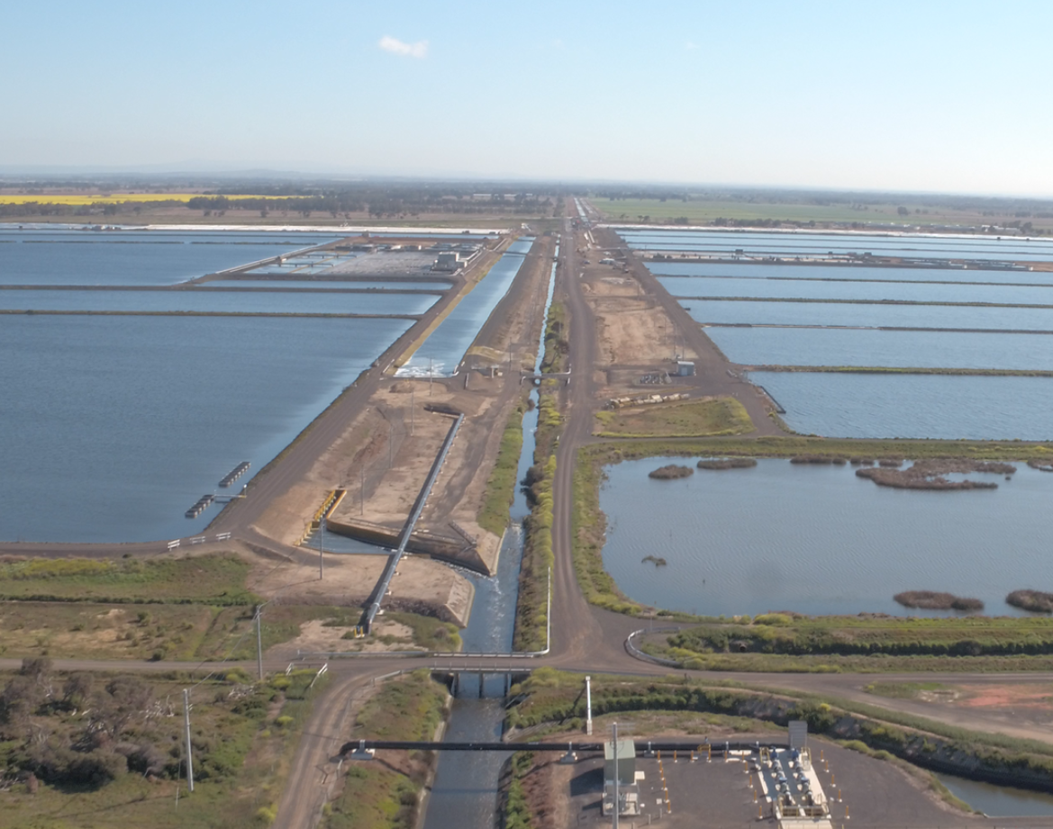
1.1: Recap
How can we manage Melbourne’s water sustainably as a valuable renewable resource?
Notes:
Teaching notes & ideas
Picture: Looking inland from Port Philip Bay(note, this image was taken before the construction commenced)
Future Water Story and the theme - How can we manage Melbourne’s water sustainably as a valuable renewable resource?
You could begin with a quick recap discussion about what students thought about their participation in the Future Water Story
Were there any surprises when playing the Future Water Story?
What was one thing that you learned about decisions that different teams had to make?
If you were to play the game again, would you make different decisions? Why?
What was the highlight of participating in the Future Water Story?
Key terms students should know to get the most out of the experience – see Glossary

Slide 6
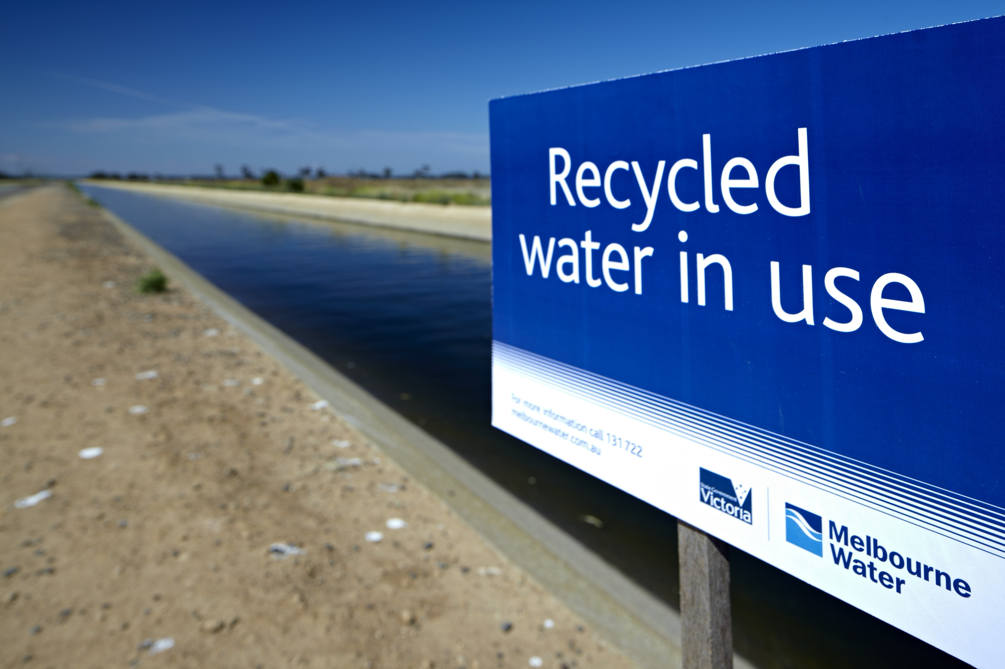
1.2: Western Treatment Plant flow chart
                Create a flow chart using images displaying the sewage treatment process at the Western Treatment Plant from where the sewage enters the Plant to the final products released at the other end.
                For each image, include an explanation about how that section of the process is sustainably managed.
Notes:
Teaching notes & ideas:
If your students completed the worksheet, they could use the information they gathered during the tour.
Students’ responses should include an outline of recycled water, biogas and biosolids, plus where each is used. For example, biogas is used on site for electricity and recycled water is used on site and for irrigation.
Websites to use:
https://www.melbournewater.com.au/water-and-environment/water-management/sewerage/western-treatment-plant/western-treatment-plant
https://www.melbournewater.com.au/teachertoolbox/virtual-tour-western-treatment-plant

Slide 7
Extend your understanding
Notes:
Teaching notes & ideas
The next slides outline the key terms and concepts that were discussed and covered as part of the Future Water Story. Students are also asked to reflect on their participation and the choices they made as part of the Future Water Story.

Slide 8
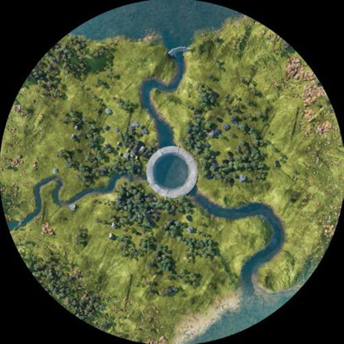
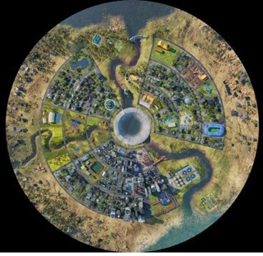
1.3: Change over time
Describe the changes in the landscape
Notes:
Teaching notes & ideas
Get students to describe the changes they see from the beginning, before settlement and at the end of Era 3.
Are these changes good or bad? How do you decide if they are good or bad?
Students should include in their response the following:
Changes in the environment
colouration of the grass
tree density and distribution
river level and clarity/turbidity
Storage and Catchment reservoir levels,
Built environment e.g. buildings present and their impacts on community
Any alternative water sources
Students could create a table or Venn diagram with two circles and outline the similarities and differences.
An alternative method to get students to respond to this task is to get them to complete a See – Think – Wonder
What do they see?
What do you think about?
What does it make you wonder?

Slide 9
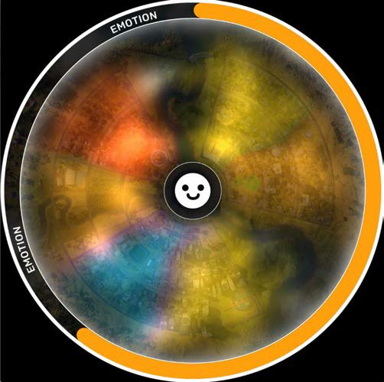
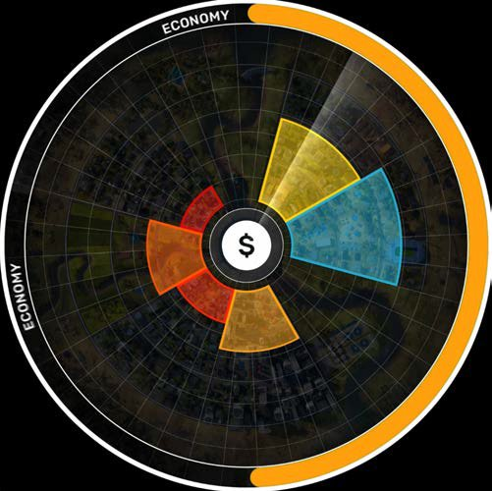
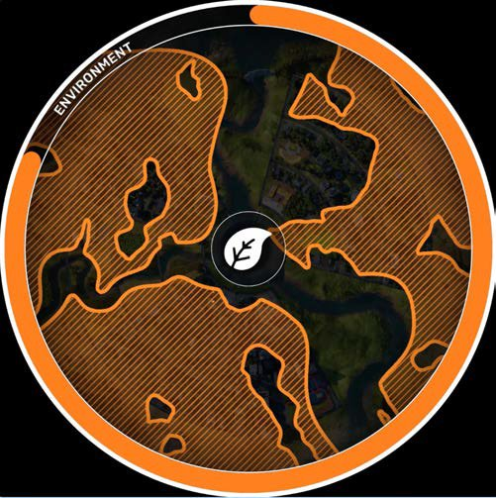
1.4: Sustainability and The Future Water Story
        The Future Water Story focuses on three pillars of sustainability: Economy, environment and emotional (social).
        Questions for discussion:
        Which of these pillars did you think was the most important when making decisions?
        Did the results of each era affect your decision in the next era? If so, how?
        Do you think that there are other pillars of sustainability that should be taken into consideration? If so, what?
Notes:
Teaching notes & ideas:
When students made decisions for their growing city while participating in the Future Water Story, they had to consider a criteria for success.
Have students work in groups to discuss and make notes about these questions. Try and create groups that have representatives from each of the stakeholder groups in them for a cross-section of ideas.
Give them 10 mins to discuss, then come back together to share.
Have students design their own pillars of sustainability in a creative way. For example, they may include education, religion, culture etc. How do these interact with each other?

Slide 10
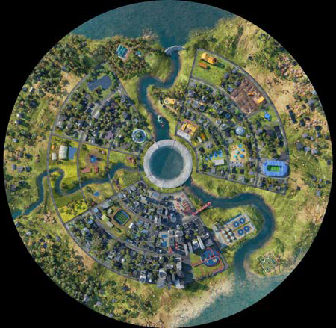
1.5: Design your sustainable city
The city’s future is in your hands!
If it were completely up to you, what decisions would you make for a growing city to ensure its success into the future?
Now it’s your turn - Design your own liveable circular city
Notes:
Teaching notes & ideas
Have students design their own circular city in their groups. This can be done digitally, on paper or in their books.
Questions to consider when designing your city:
What do you need to consider including in your city for a growing population?
How will you consider water security for your city?
Would you include alternative water sources or recycling water?
What do you need to include to make sure that your city is accessible and liveable?
What do you think you want to avoid including in your city?
What are the important stakeholder groups do you think you would include to make decisions in your city?
Allow students to present their city back to the group and explain how they came to their conclusions.

Slide 11
Bringing it together
Notes:
Teaching notes & ideas
In this section, students draw on their knowledge and respond to the theme How can we manage Melbourne’s water sustainably as a valuable renewable resource?

Slide 12
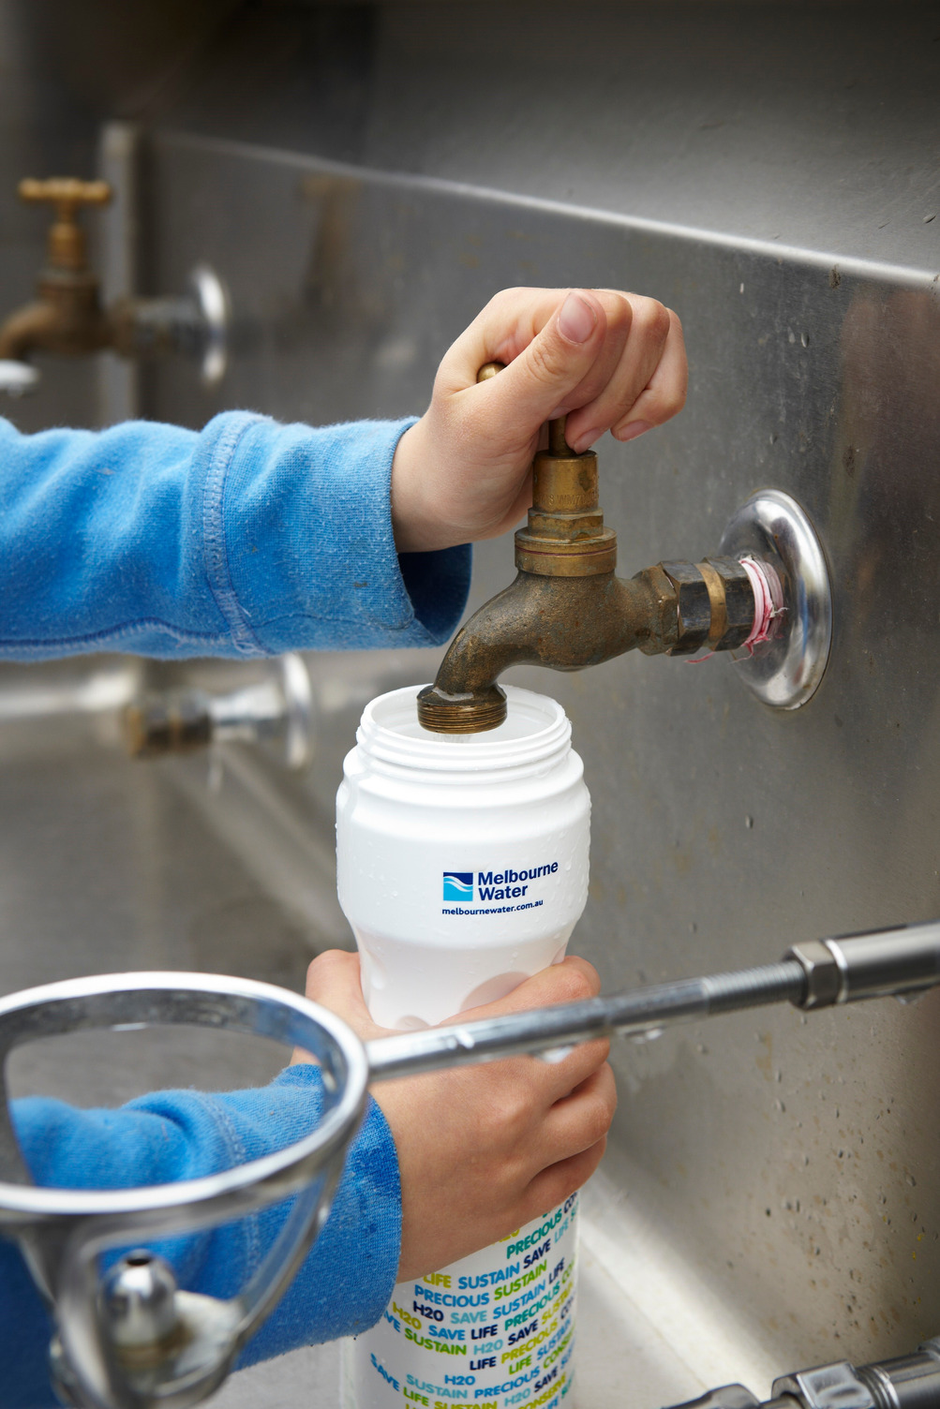
1.6: Water management plan
Develop a sustainable water management plan for the next 100 years to answer the question:
How can we manage Melbourne’s water sustainably as a valuable renewable resource?
In your stakeholder groups from the Future Water Story, develop a sustainable water management plan for the next 100 years for your community.
You will need to consider:
    The changing climate and the impacts that will have over the next 100 years
    Viewpoints of your stakeholder group – what is important to them?
    What are individual actions people can take?
    What collective action should the community take over the next 100 years?
    How your plan incorporates the sustainability pillars
    3. Present this back to your class via poster, multimedia or video.
Notes:
Teaching notes & ideas:
It is now time to answer the question - How can we manage Melbourne’s water sustainably as a valuable renewable resource?
Encourage students to think about alternative water sources, desalination, recycled water and stormwater harvesting.
Encourage them to think like the stakeholder group that they originally were assigned, or alternatively have them think of other important stakeholder groups that would be important in the community.

Slide 13
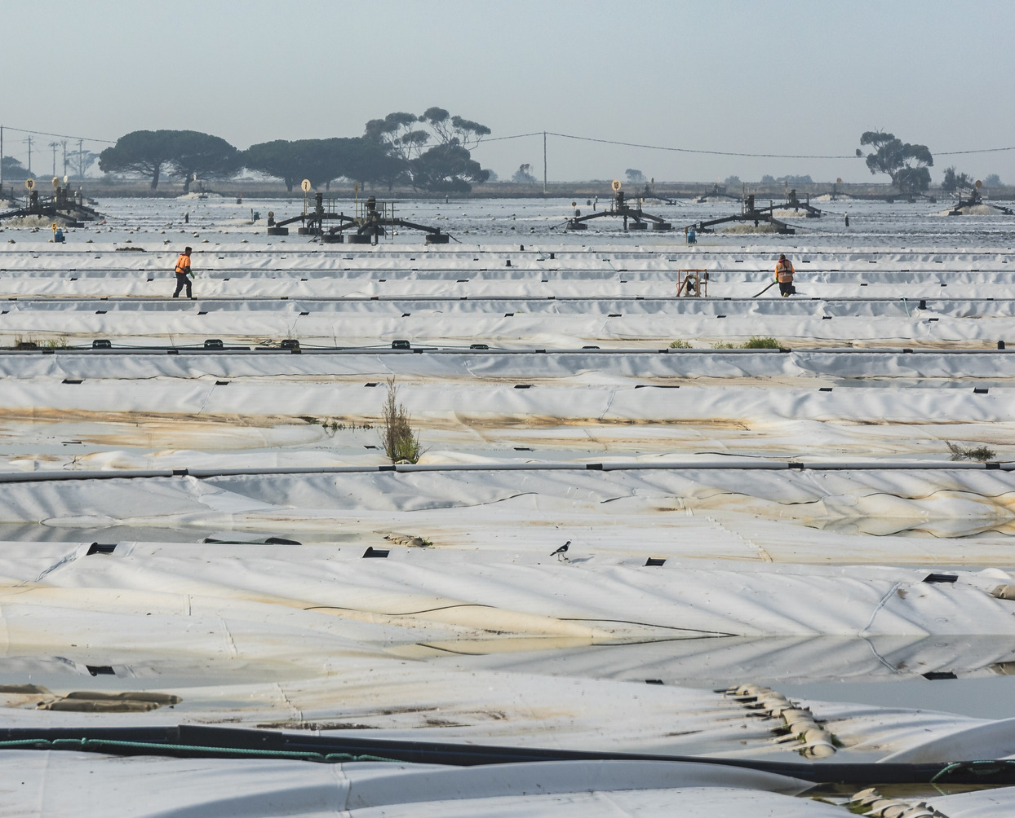
1.7: Reflection
Complete these sentences to reflect on how your thoughts have changed about water and water security and management.
    I used to think…
    Now, I think…
    In the future, I will…
Notes:
Teaching notes & ideas:
Use these simple prompts to have students reflect on their learning.

Slide 14
Thank you

Slide 15
Glossary
Word | Definition
activated sludge process | A sewage process in which solids are separated from wastewater using bacteria and aeration. Organisms such as bacteria degrade organic material and remove nutrients using oxygen before they are separated from the treated water
aerator | A device for mixing air into the sewage
aerobic | a process which requires oxygen. In sewage air is mixed into the sewage to encourage certain bacteria to help break down the waste
anaerobic | This is a process which does not require oxygen. In this case some bacteria work without oxygen to help clean the waste
aquifers | layers of rock that can store large quantities of water
Biogas | a renewable energy resource produced by micro-organisms such as methanogens
biosolids | a sludge by-product of the sewage treatment process. Some of this is nutrient- rich and can be reused for many purposes including agricultural use or energy production
blue water | fresh surface water and groundwater, such as lakes, rivers and aquifers
brine | a very salty solution
catchment | an area of land where water (from precipitation) is collected by the natural landscape. The water then flows or drains into rivers, creeks, dams, lakes or into a groundwater system
dam | a structure built across a river to control the river’s flow and create a reservoir (lake)
desalination | the removal of salts from seawater or other saline (salty) solutions
drainage basin | the area where water collects and moves towards a river and its tributaries (branches of water from the main river; also known as a catchment or river basin
drought | a prolonged (lengthy) period of below-average rainfall
groundwater | water beneath the Earth’s surface that fills pores or tiny spaces in materials such as sand, soil or gravel
green energy | energy (electricity) produced using renewable resources, such as wind or sunlight, without creating greenhouse gases
green water | the precipitation (rainfall) on land that does not run off or become groundwater, but is stored in the soil or temporarily stays on top of the soil or in vegetation

Slide 16
Glossary of terms that might be used on your excursion
Word | Definition
grey water | water generated from domestic activities such as washing clothes, dishwashing and bathing
heatwaves | short periods (usually no longer than a few days) of well-above-average temperatures
non-potable | water that is not safe to drink but can be used for other purposes
ponds/ lagoons | large ponds for treating the sewage. The sewage flows through the ponds, gradually becoming cleaner as bacteria break down the organic matter in the water
potable | water that is safe to drink
river basin | land that acts as a container for water to flow towards a main river or ocean; also known as a catchment or drainage basin
run-off | the movement of surface water across the land and down slopes
reservoir | a large natural or artificial lake used as a source of water supply
sanitation | the infrastructure related to the collection and disposal of sewage (human waste)
sewage | the wastewater that leaves our kitchens, bathrooms, laundries and toilets, as well as from industry and businesses
sewerage | the network of pipes and pumps that carry away wastewater and human waste from houses and other buildings
stormwater | water from rain or storm events that flows off a house or building
virtual water | the volume of fresh water that is consumed (or polluted) when a product is created
wastewater | water that is discharged from homes and businesses and sent to the treatment plant
water allocation | the amount of water a water user with a water access licence is allocated against their licence in a water year/ A water allocation is an authority to take water, and an entitlement to a share of the available water resource in a catchment
water budget | an account of the water stored in a system, such as a watershed, and the movement of water in and out of that system. The equation used to calculate a water budget broadly includes precipitation, water flow into a system, water flow out of a system, changes in water storage, and evapotranspiration
water cycle | the processes of water passing from and to the Earth’s oceans, atmosphere and land
water footprint | the total volume of fresh water used by an individual, a household, a business, a community or a country
water scarcity | a situation in which the demand for water is greater than the amount available
watersheds | the boundaries between catchments
water stress | the negative effect that water scarcity can have on people and environments

